Slide 1

Predicting Market Price Movements During the Pandemic
Daniel Bachalis
Naveen Nagarajan
Gurjivan Kalkat

Slide 2

Research Statement
We used data mining techniques to do the following:
Determine if Covid 19 factors are relevant variables in order to determine the returns of equity indices and cryptocurrency
Develop Covid-19 prediction model to leverage for pandemic duration prediction.
Compare Data beginning from the pre pandemic levels starting from 2019 until March 2021, to observe how different asset classes and macroeconomic data has been affected by Covid-19
Make recommendations for portfolios and asset allocation in order to maximize returns and hedge against risk.
Determine if data from different asset classes from January 2019 to March 2021 can effectively model the returns of Bitcoin, SPX, NDX, and DJIA

Slide 3
Data Extraction
Data was extracted from Bloomberg terminal
Features cleansed – Date (%y-%m-%d), GDP and Unemployment
Log returns applied on SPX, NDX, BTC, DJIA
Feature | Description
TLT | iShares 20 Plus Year Treasury Bond ETF
DJIA | Dow Jones Industrial Average
NDX | Nasdaq-100
GOLD | Gold price
Oil | Crude oil price
SPX | S&P 500
TSA | TSA checkpoint travel numbers
Cases | COVID Cases
Deaths | CoVID Deaths
Bitcoin | Bitcoin daily price
GDP | US GDP
Unemployment | Unemployment statistics
Data | Function
TSA Throughput | TSATTPCY
CoVID-19 Cases | NCOVUSCA
CoVID-19 Recovered | NCOVUSRE
CoVID-19 Deaths | NCOVUSDE
CoVID-19 Vaccine administered | NCOVUSVA
S&P 500 | SPX Index
Dow Jones | INDU Index
Nasdaq Composite | CCMP Index
Gold | XAU Curncy
Crude oil futures | C01 Comdty
Bitcoin/USD | XBTUSD
GDP, Non-farm payroll | ECST
Feature Description
BBG Terminal functions

Slide 4

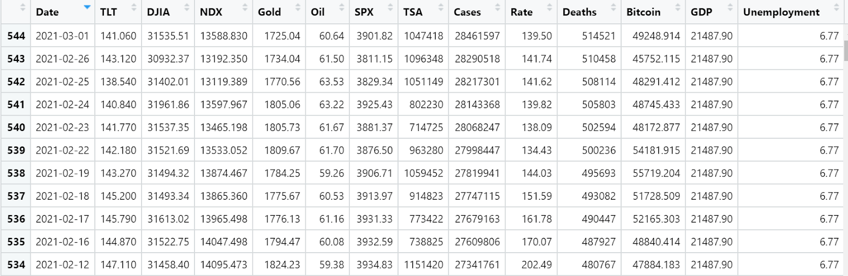
Data and EDA

Slide 5
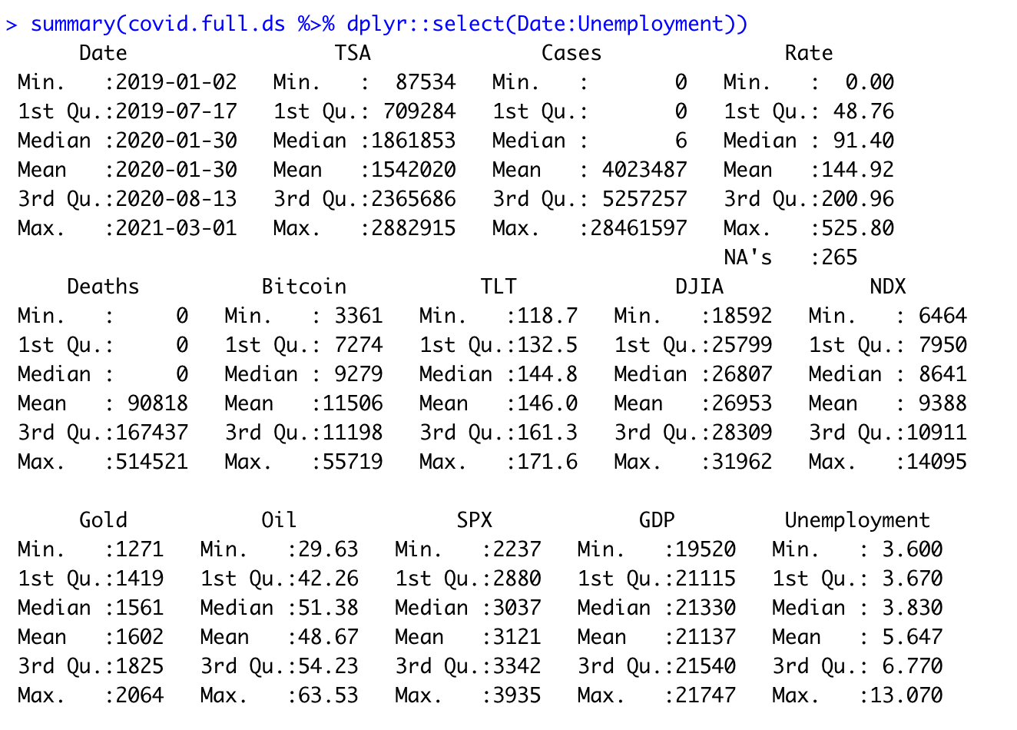
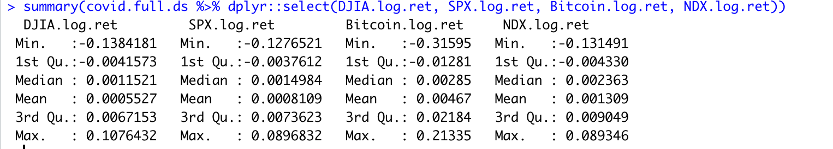
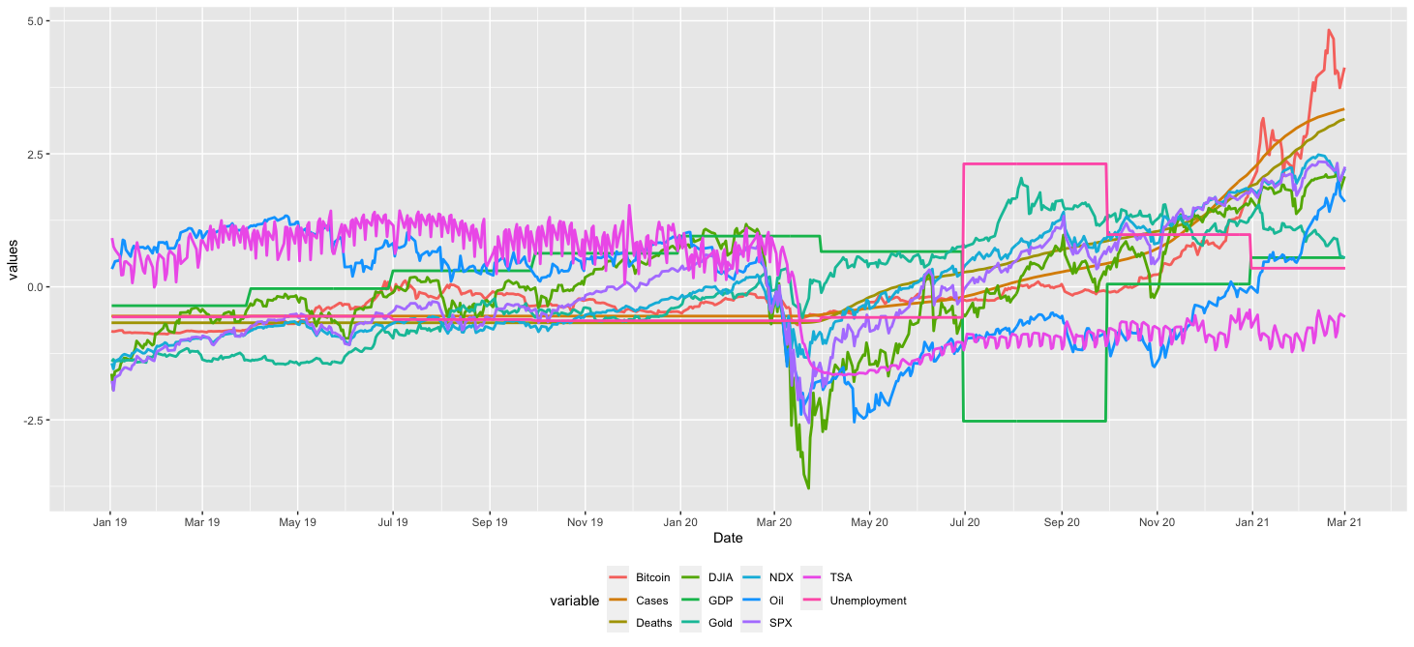
Summary Statistics
Timeseries chart

Slide 6
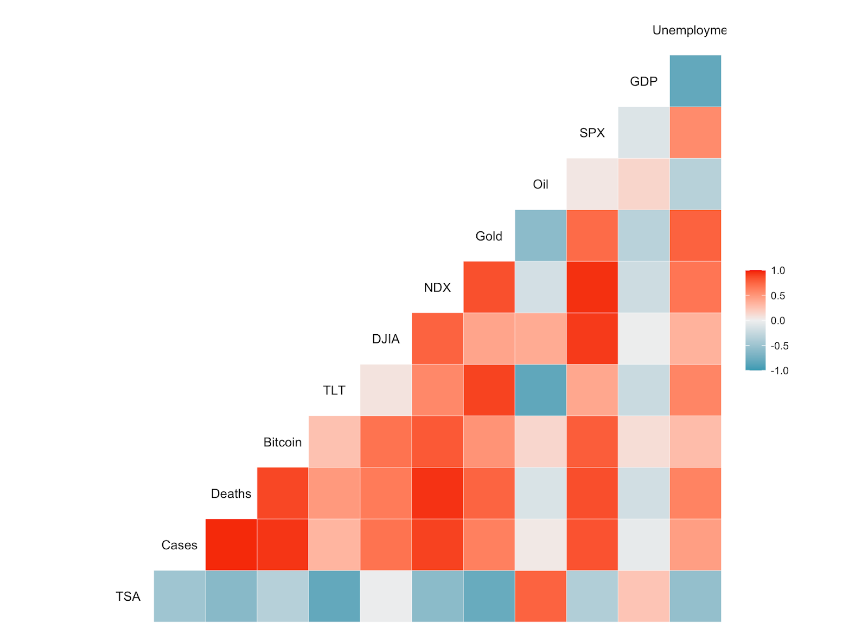
Correlation Matrix

Slide 7

Modeling
Predictors
TSA, Gold, TLT, Oil, Unemployment, GDP, Cases, Deaths
Response variable
SPX, NDX, DJIA, BTC
Log Returns <-> Binary response
Binary Classification
Built Linear and Tree based models
Linear Models
1. GAM
2. KNN
3. LDA
4. QDA
Tree Models
1. Random Forest
2. XGBoost

Slide 8
GAM
An additive modelling technique where the impact of the predictive variables is captured through smooth functions
The GAM function displays the statistics of the data in two fashions one where it is considered to have non-parametric effects and the other where it is considered to be parametric.
To analyze the importance of these variables is through the Pr(>F) values from the results which shows they were statistically significant

Slide 9
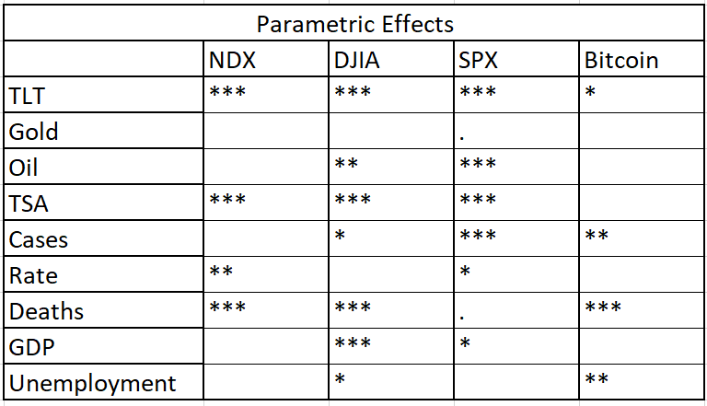
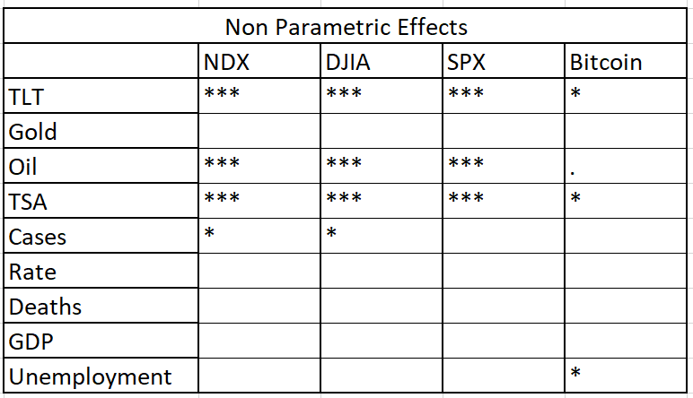
GAM

Slide 10
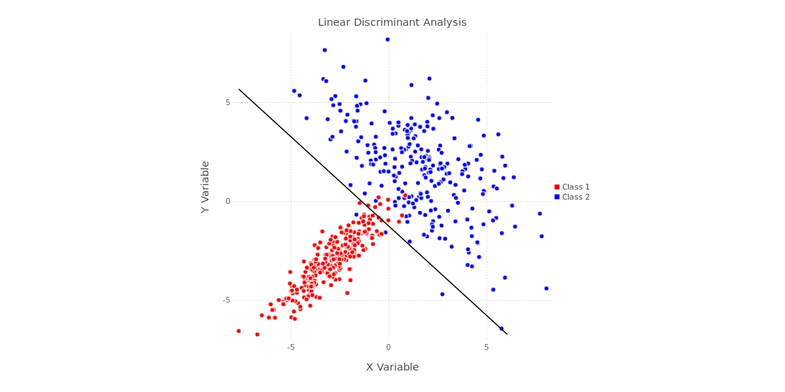
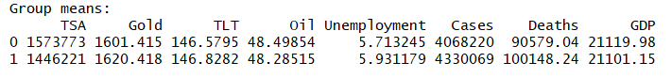
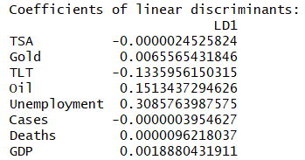
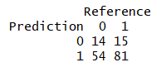
LDA
Notes:
Linear Discriminant Analysis is a statistical model that generates a linear equation in order to classify data based on categorical variables. The model attempts to optimize discriminants (weights) for each variable in order to maximize the distance between different categories, thus optimizing prediction capabilities. LDA assumes that the sample is random and each predictor variable is normally distributed. For LDA, in this case, the only optimization decisions are to select an appropriate dataset for training and testing as well as variables that are significant as predictors of your target (we don’t have prior probabilities, the default tolerances are acceptable, etc.)
As with the GAM model, LDA and QDA are simple in the sense that there aren’t any parameters to optimize, besides selecting the variables and training data used for the model. LDA assumes feature covariance matrices are the same, which results in a linear decision boundary, whereas QDA allows for different covariance matrices and results in a quadratic decision boundary. Both focus on maximizing the seperability among known categories (i.e. group means). In all cases, the results of both models showed that the group means for each category were relatively close to each other. This would be manageable if the respective scatter was very small; however, looking at the relatively low accuracy across the board (see performance tables in the Sampling section below) indicates that this is not the case. LDA tended to have better accuracy but poorer specificity than QDA.

Slide 11
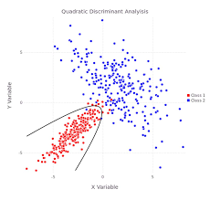
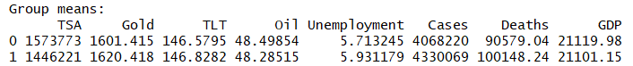
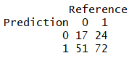
QDA
Overall, similar or worse performance than LDA
Notes:
Quadratic Discriminant Analysis is similar to LDA however, it assumes that each variable has its own covariance matrix, an assumption that LDA does not make. This leads to a quadratic equation for classification. Like LDA, there is not any optimization to do besides selecting the best variables and dataset.

Slide 12
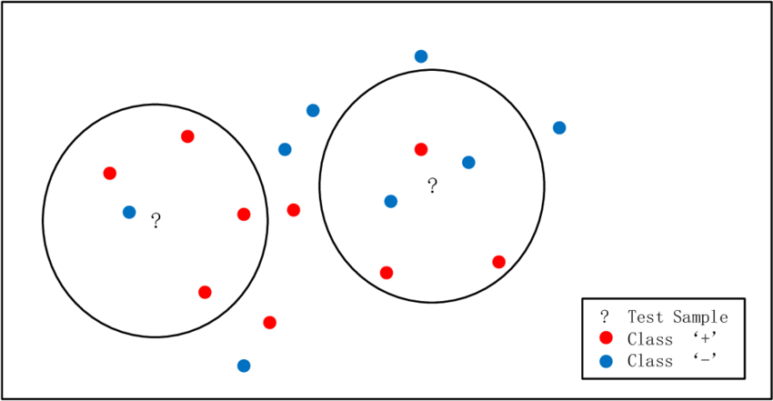

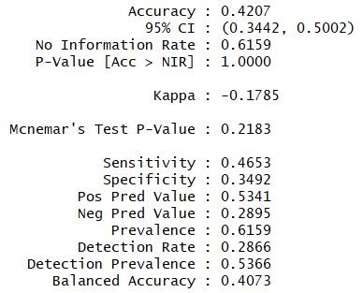
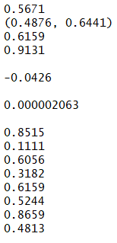
KNN
k =1
k =100
Specificity
Accuracy
Notes:
K Nearest Neighbor attempts to classify data points based on points that are the most similar to it. The model evaluates k (number) points in the training data that are closest to a test point to make a guess at the classification. KNN is optimized mainly by testing and selecting the optimal k-value (i.e. how many nearest neighbors to evaluate when classifying any given test point).
For KNN, various k-values were tested (1, 2, 3, 5, 10, 20, 50, 100). This allowed us to evaluate the correct number of neighbors to evaluate by plotting k vs. the error rate. Unfortunately, things weren’t so easy. It did not seem to matter which k-value was chosen (see Results) when it came to the forecasting dataset. For the 70:30 dataset, lower k-values provided better specificity and reduced false positives. As k was increased, the model increased in accuracy but decreased in specificity (tending toward more positive predictions). The exception was with predicting returns in Bitcoin. Lower k-values (k = 1 or 2) provided both better accuracy and specificity.

Slide 13
Random Forest
Random Forest attempts to build a “forest” which is an ensemble of decision trees, usually trained with the bagging algorithm which is a combination of learning models that increase the overall result. Random forest decorates the trees by choosing a sample of m predictors from original p predictors, thereby making the average of the resulting trees less variable and more reliable.
In random forest mtry (Number of variables randomly sampled as candidates at each split) and ntree (Number of trees to grow) parameters were calibrated to get the best results.
Typical number of predictors for a split candidate is chosen to be m ≈ √p and for this scenario after multiple trials we obtained optimal accuracy with mtry = 5 and tree size = 2000.
Variable of importance plots based on Mean decrease accuracy and gini indicates that Gold, GDP, CoVID Deaths, CoVID Cases, Unemployment contributed significantly to the model

Slide 14
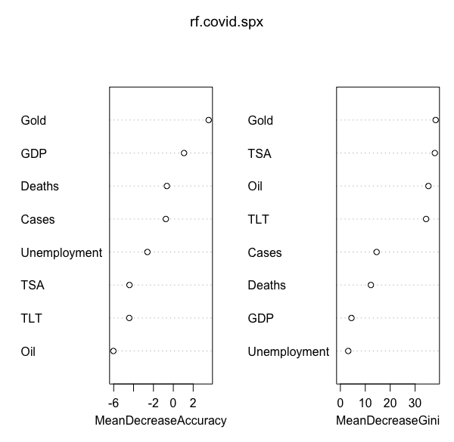
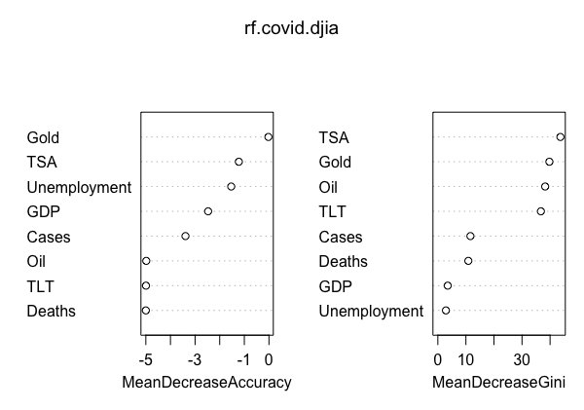
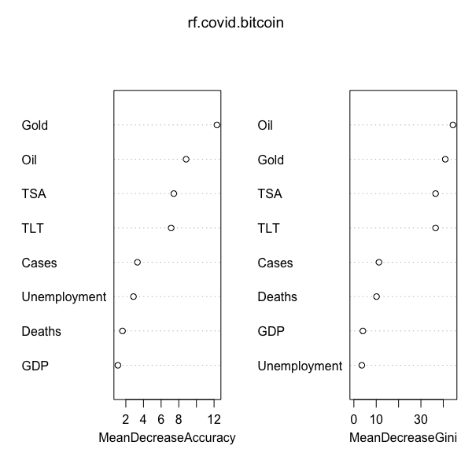
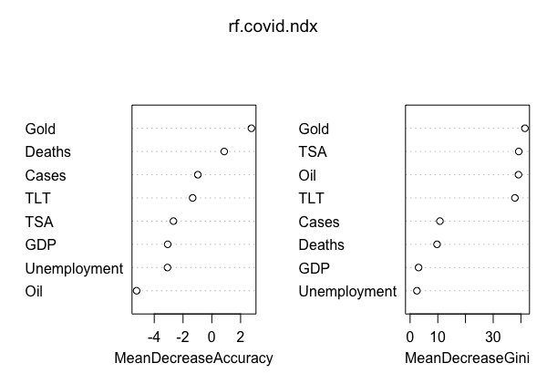
Variable of importance
SPX
DJIA
DJIA
SPX
BTC
NDX
NDX
BTC
Confusion Matrix

Slide 15
XGBoost
Extreme Gradient Boosting is an optimized distributed gradient boosting library designed to be highly efficient and flexible. Gradient Boosting attempts to minimize the loss function by adding weak learns using a gradient descent optimization algorithm.
XGBoost has 4 builtin tree methods, namely exact, approx, hist and gpu_hist. Overfitting can be controlled in XGBoost using max_depth, min_child_weight and gamma, subsample and eta parameters
For training boosted tree models, there are 2 parameters used for choosing algorithms, namely updater and tree_method. Parameter updater is more primitive
Various parameters eta, gamma, nrounds, booster, sampling method, subsample, tree method were tried and optimal accuracy were obtained using max_depth=100, eta=0.2, nrounds=100, gamma=0.5, tree_method=exact with binary:logistic as objective function. Variable of importance suggests TSA, Gold, Oil, TLT, Oil and CoVID Cases played significant roles in the model construction. Accuracy was highest for SPX prediction with value of 0.6196

Slide 16
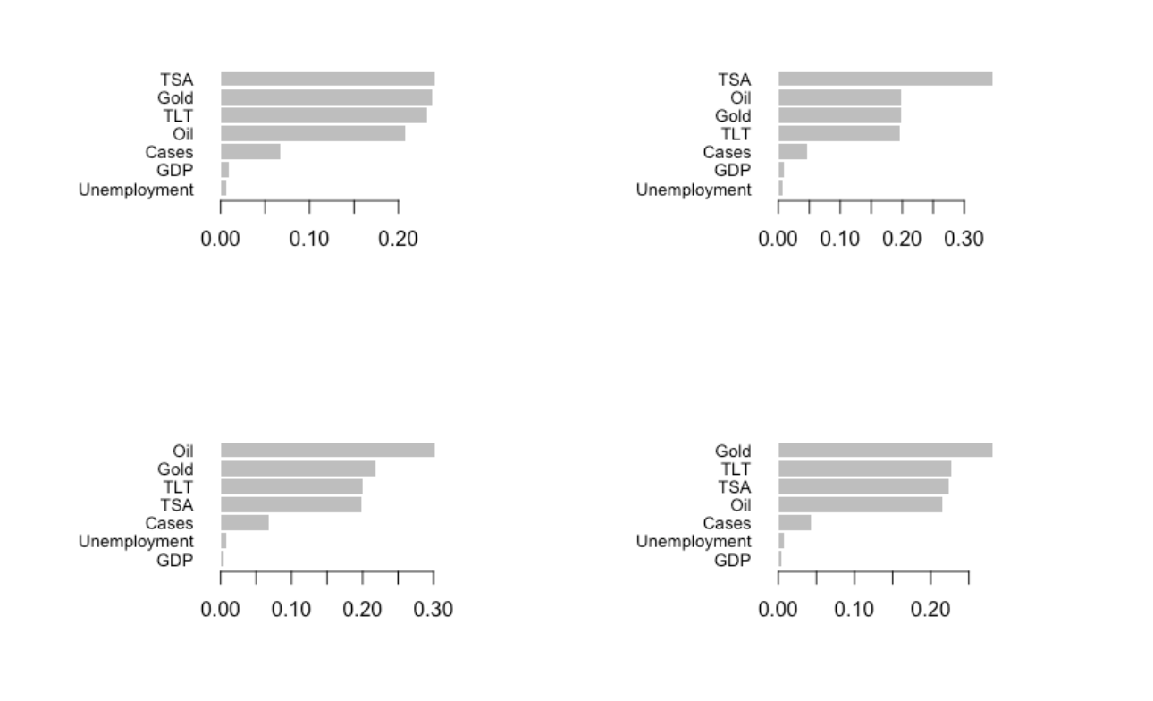
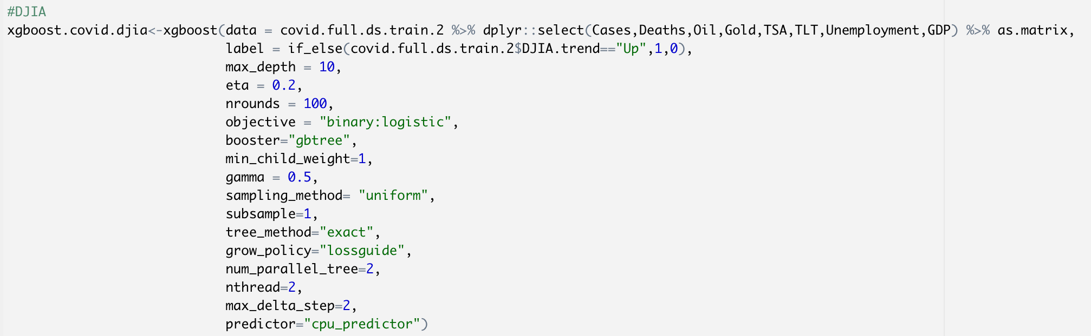
Variable of importance
SPX
BTC
SPX
BTC
DJIA
NDX
DJIA
NDX
Confusion Matrix

Slide 17

Results

Slide 18
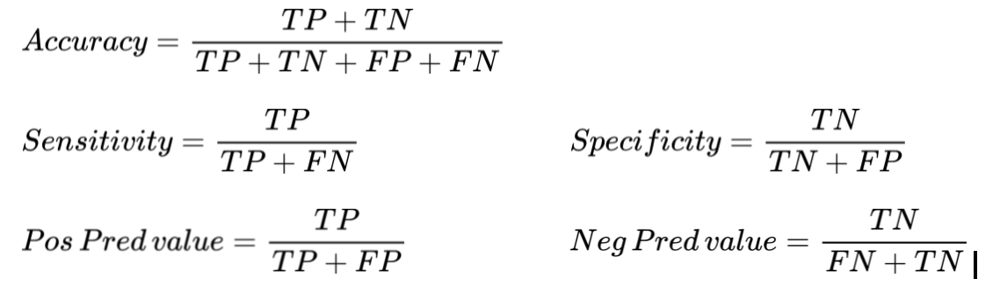
Model Evaluation
For evaluation of the model, the accuracy, sensitivity, specificity, Pos Predicted value, Neg Predicted values was measured.

Slide 19
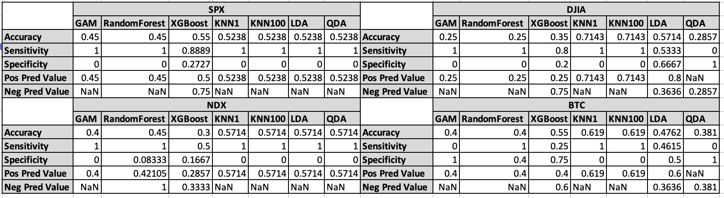
Forecast
Training : 1/3/2019 to 1/31/2021 , Test : 2/1/2021 to 3/1/2021

Slide 20
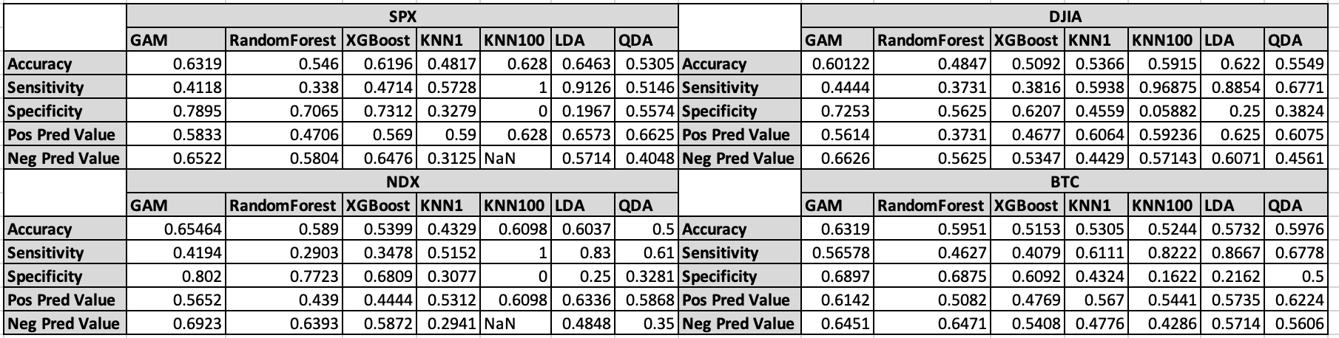
Sampling
Training: 70% , Test: 30%

Slide 21


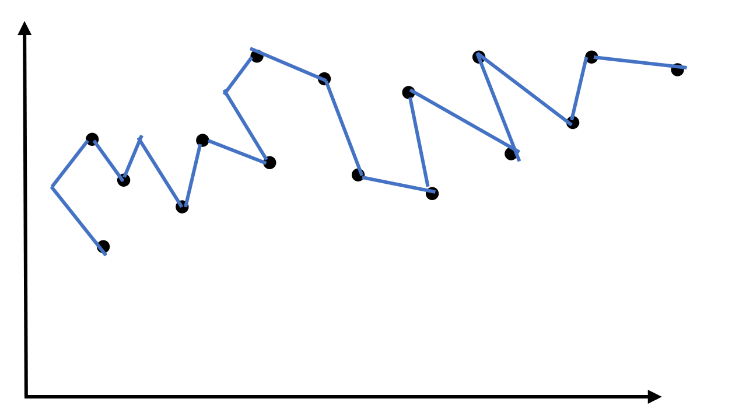
Conclusions
The pandemic did not have a strong effect on the market as a whole and other factors, not considered here, balanced out any overall negative effects
Each of the models is not particularly accurate
Weaknesses to our models such as overfitting on the data in our forecasting scenario

Slide 22



Recommendation
Invest in the market and everything will continue to give pos returns, however there are weak points to that argument
Issues: the inaccuracy of the models, small dataset, and additional factors, as mentioned above
Additional testing needed:
More data (over time), additional factors (such as government intervention) and possibly other types of models (time series with rolling window) should be explored to improve on the results

Slide 23
Thank You Questions?

